Slide 1

COURIER, EXPRESS, AND PARCEL (CEP) MARKET
Andy Fernandez| Bamidele Funminiyi "Sam“ | Godday Ogbo

Slide 2
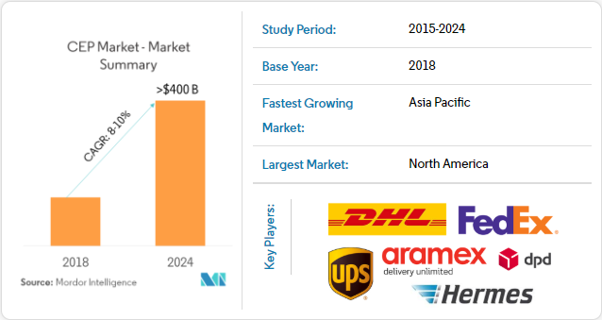
COURIER, EXPRESS, AND PARCEL (CEP) MARKET GROWTH, TRENDS, & FORECAST (2019 - 2024)
Source: mordorintelligence.com

Slide 3
Goals & objectives
Use machine learning to build customer model for CEP company (UPS)
IDENTIFY marketing & sales opportunities from existing customer base & prospects
Map to visualize data & optimize marketing & sales STRATEGY & resources

Slide 4
Data & TOOLS
CUSTOMER DATA FROM
CEP COMPANY (UPS)
PYTHON, PANDAS, MATPLOTLIB, SQL & TABLEAU
3RD PARTY BUSINESSES DATA FROM DUN AND BRADSTREET (DNB.com)

Slide 5
METHODOLOGY
SQL – extract data from data warehouse & transform
Python – use regression to build customer model & apply model to 3rd party business database (DnB)
Tableau – load results for visualization (graphs & maps)

Slide 6
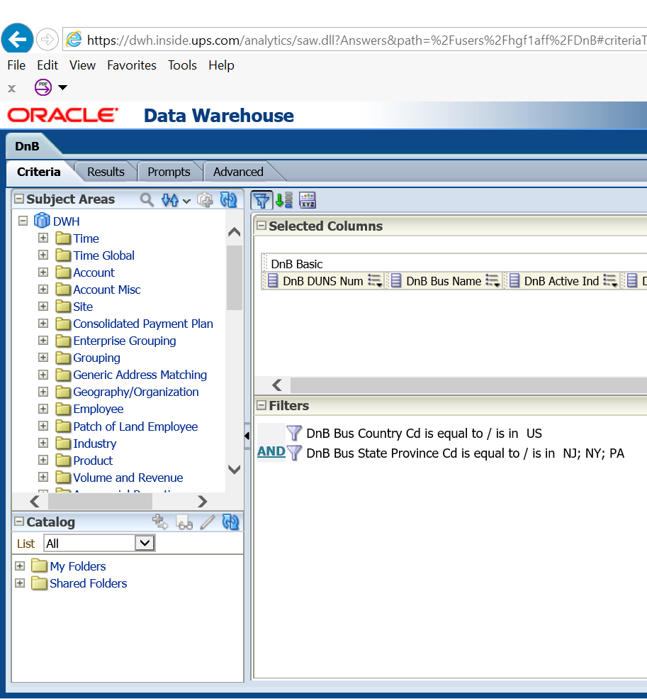
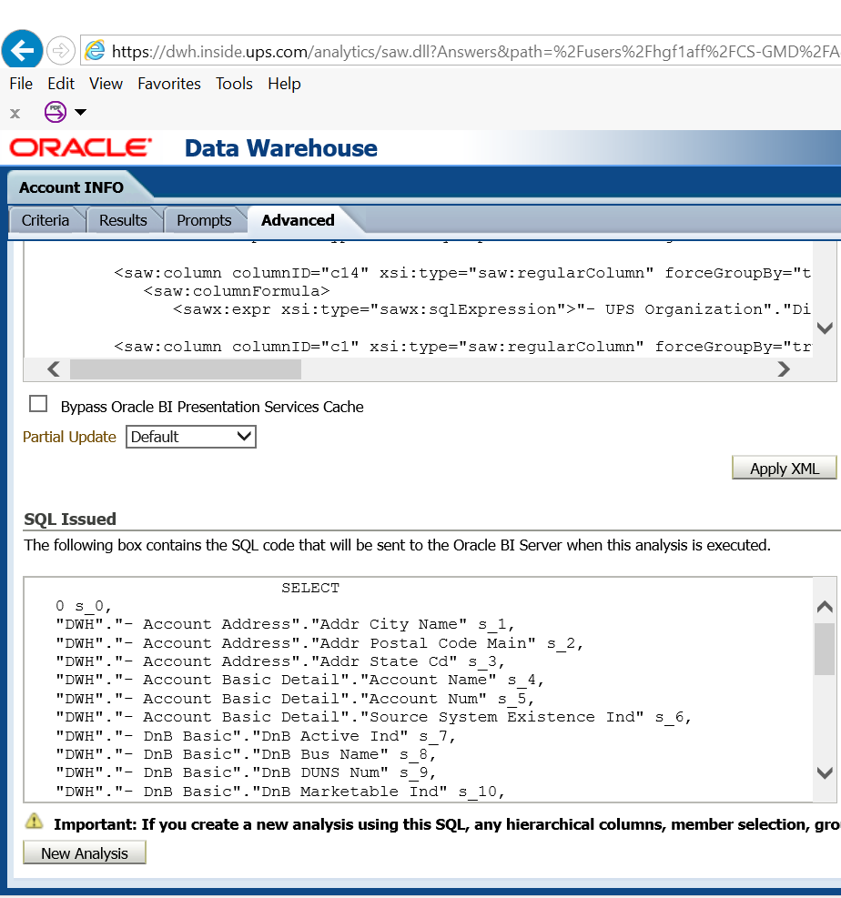
Sql – data warehouse

Slide 7
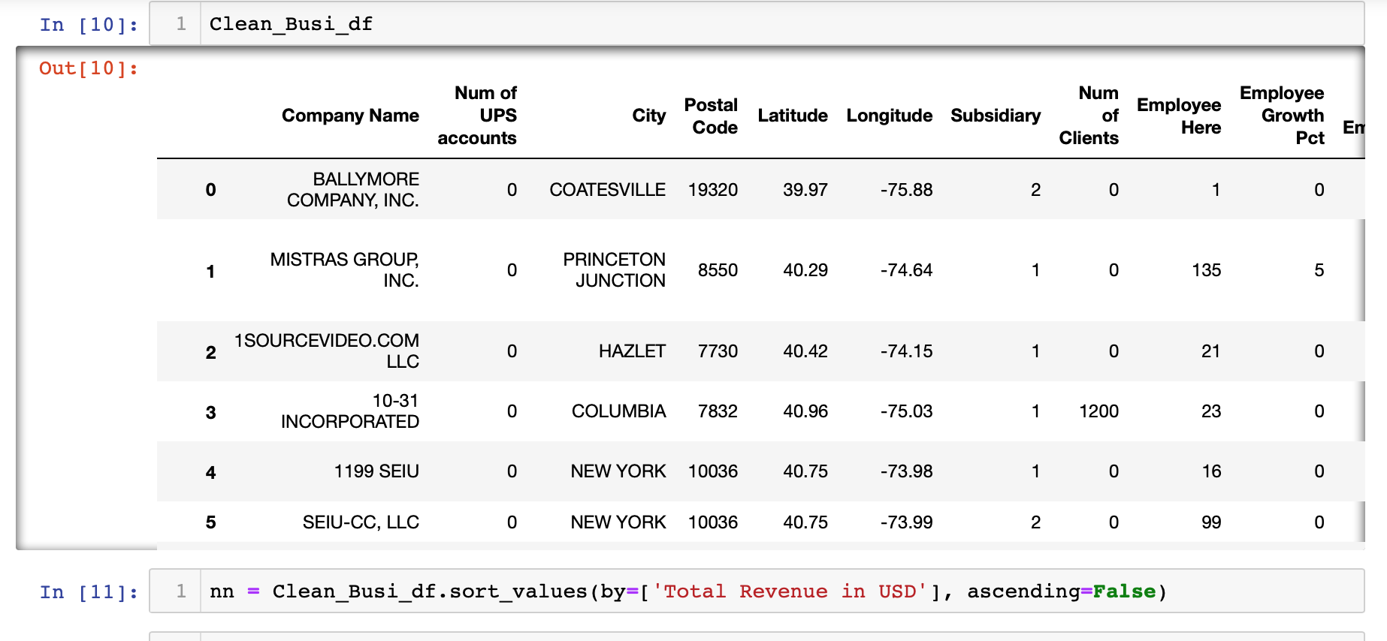
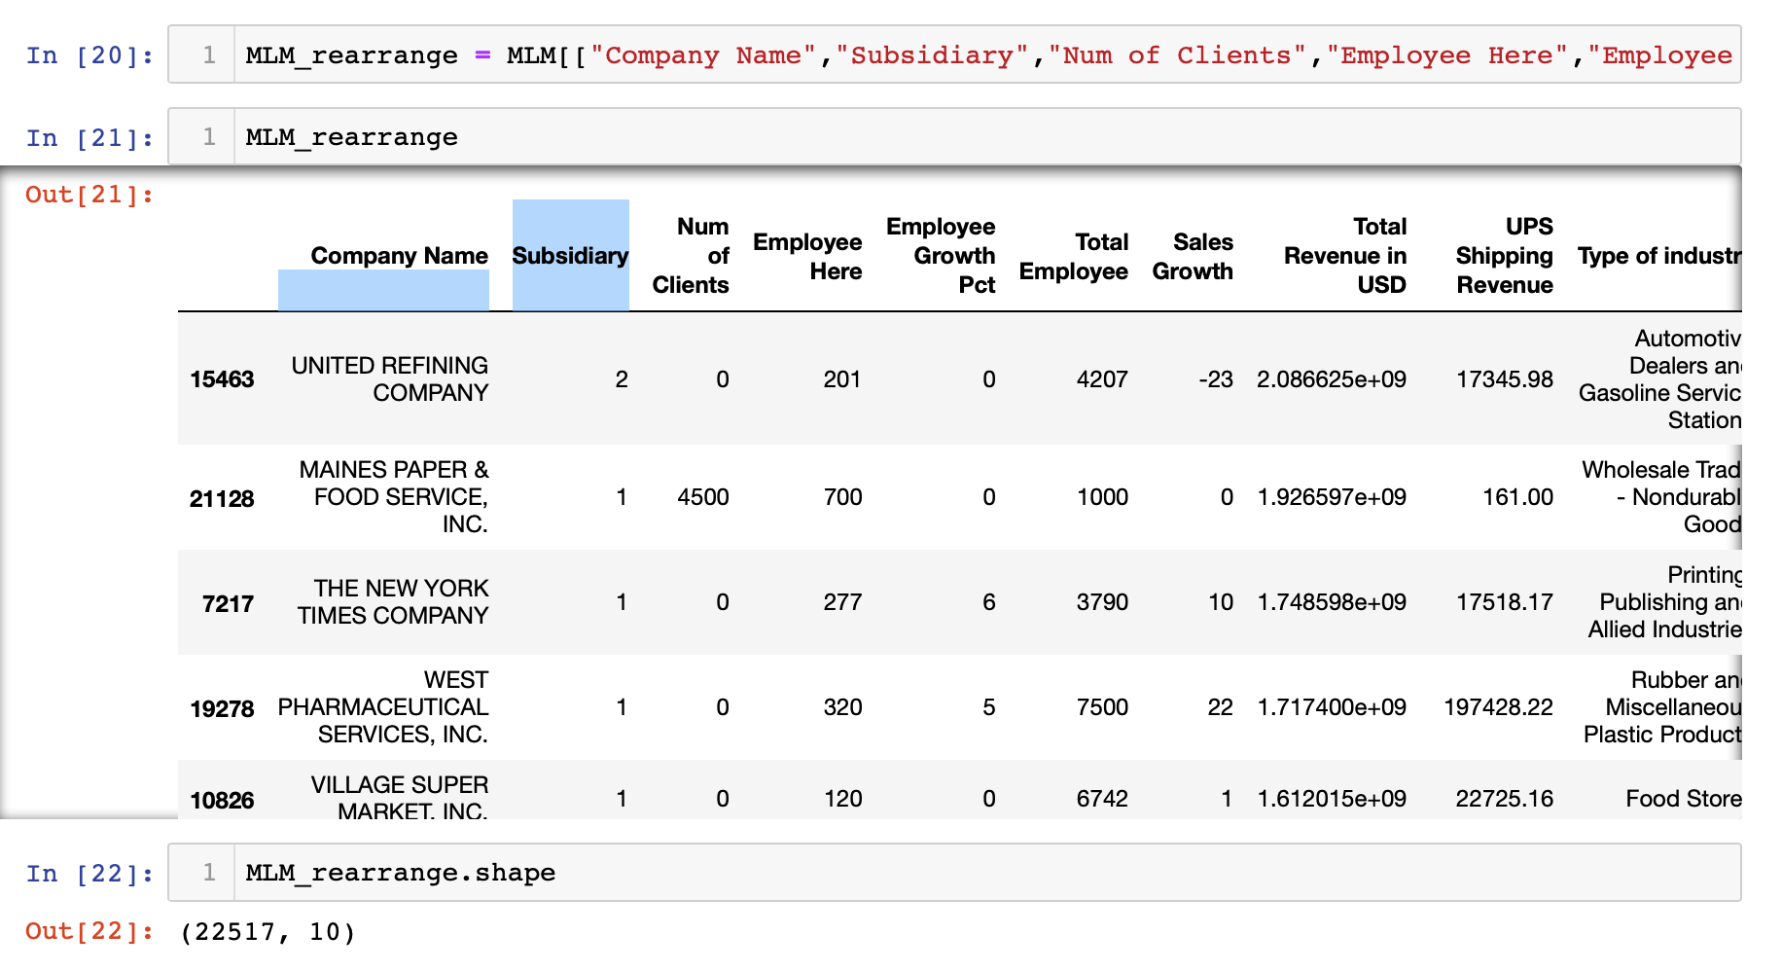

Python – data

Slide 8
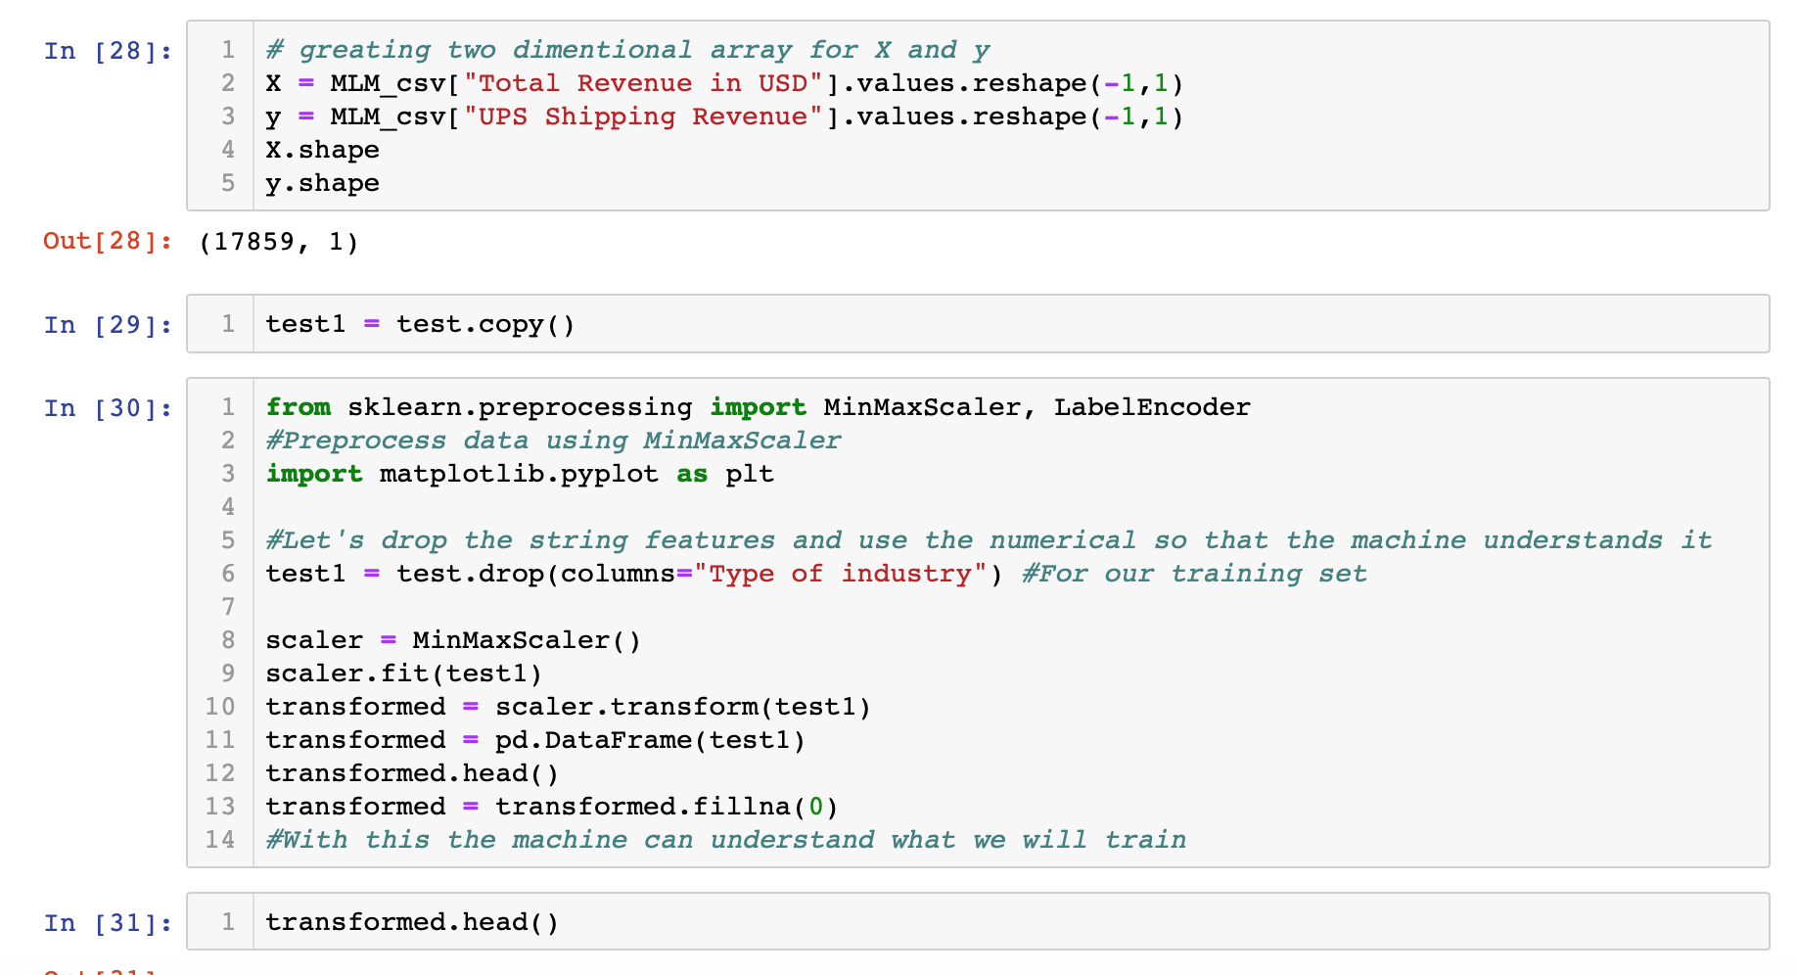
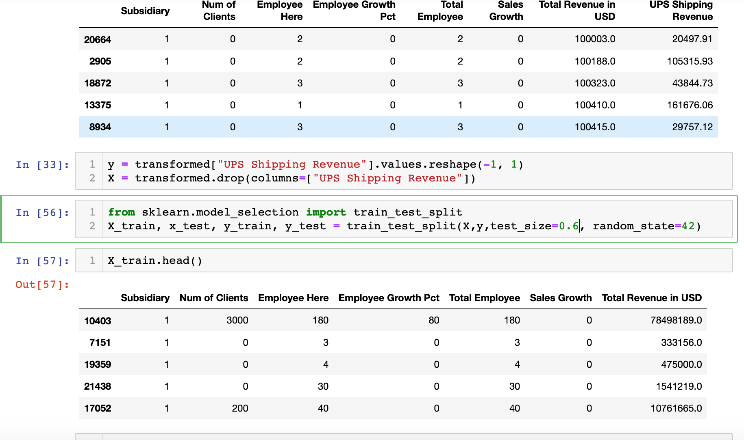
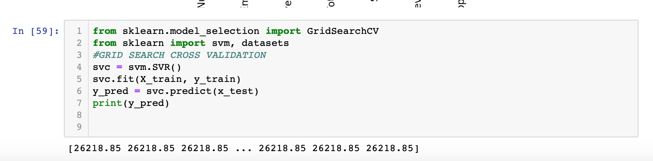
Python – data

Slide 9
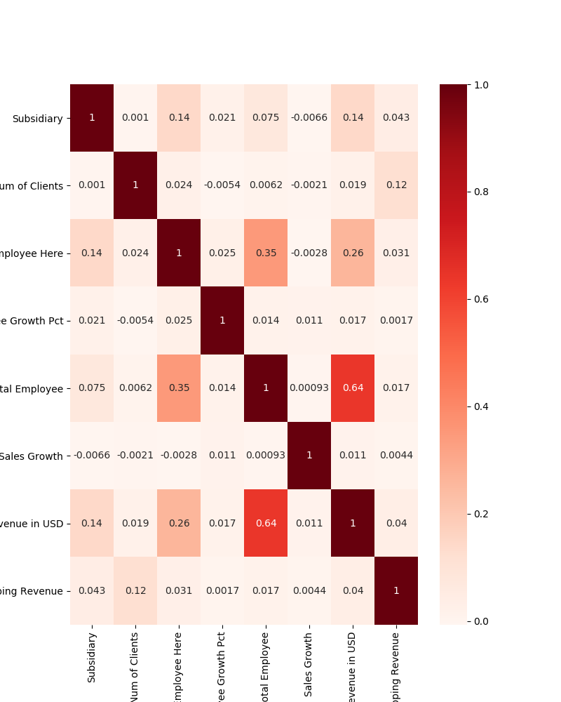
PYTHON
DATA
ANALYSIS
MACHINE
LEARNINE

Slide 10
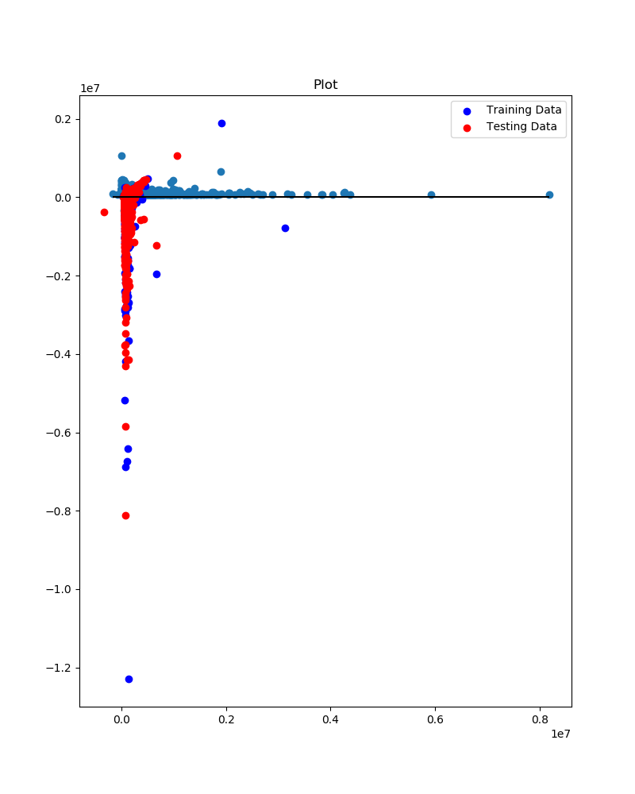
PYTHON
DATA
ANALYSIS
MACHINE
LEARNINE

Slide 11
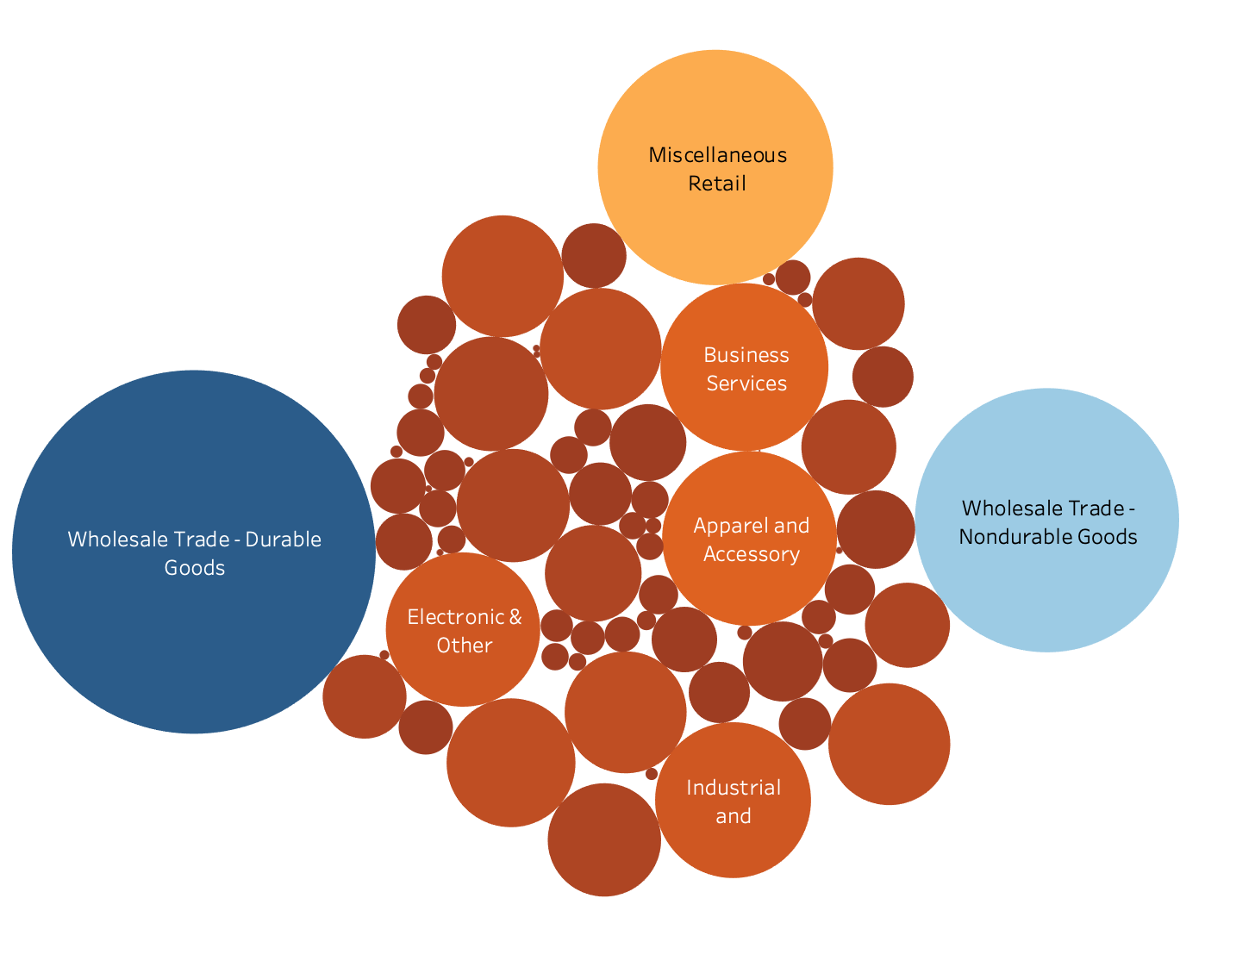
Tableau – INDUSTRY

Slide 12
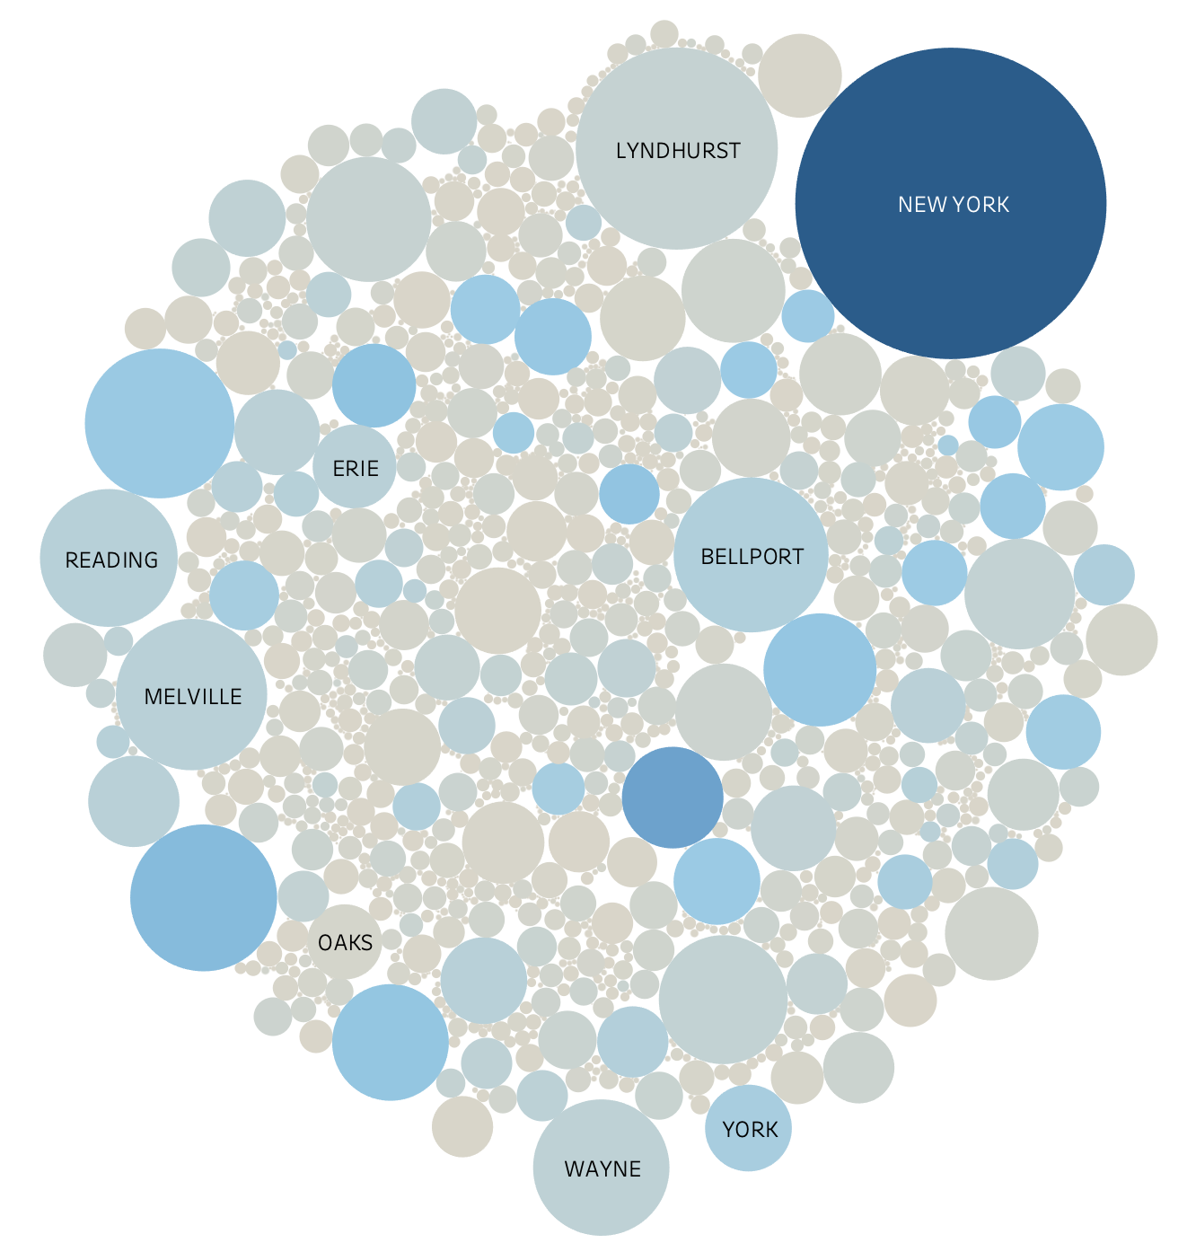
Tableau
city

Slide 13
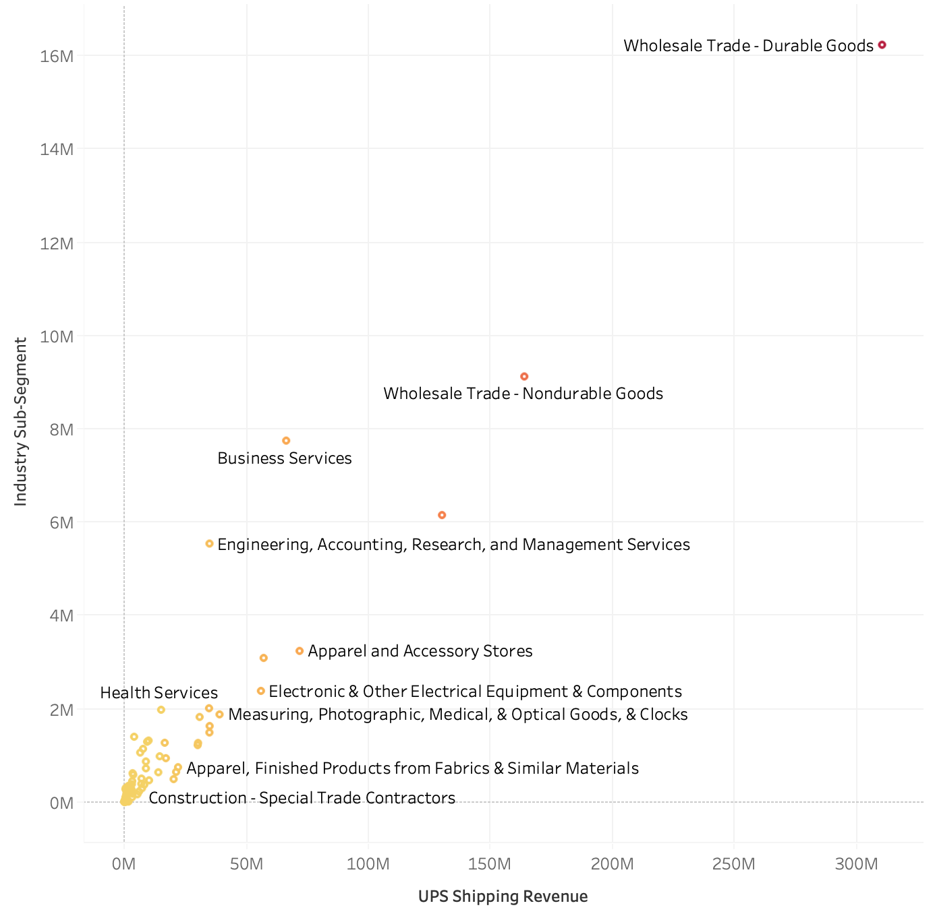
Tableau
Industry
revenue

Slide 14
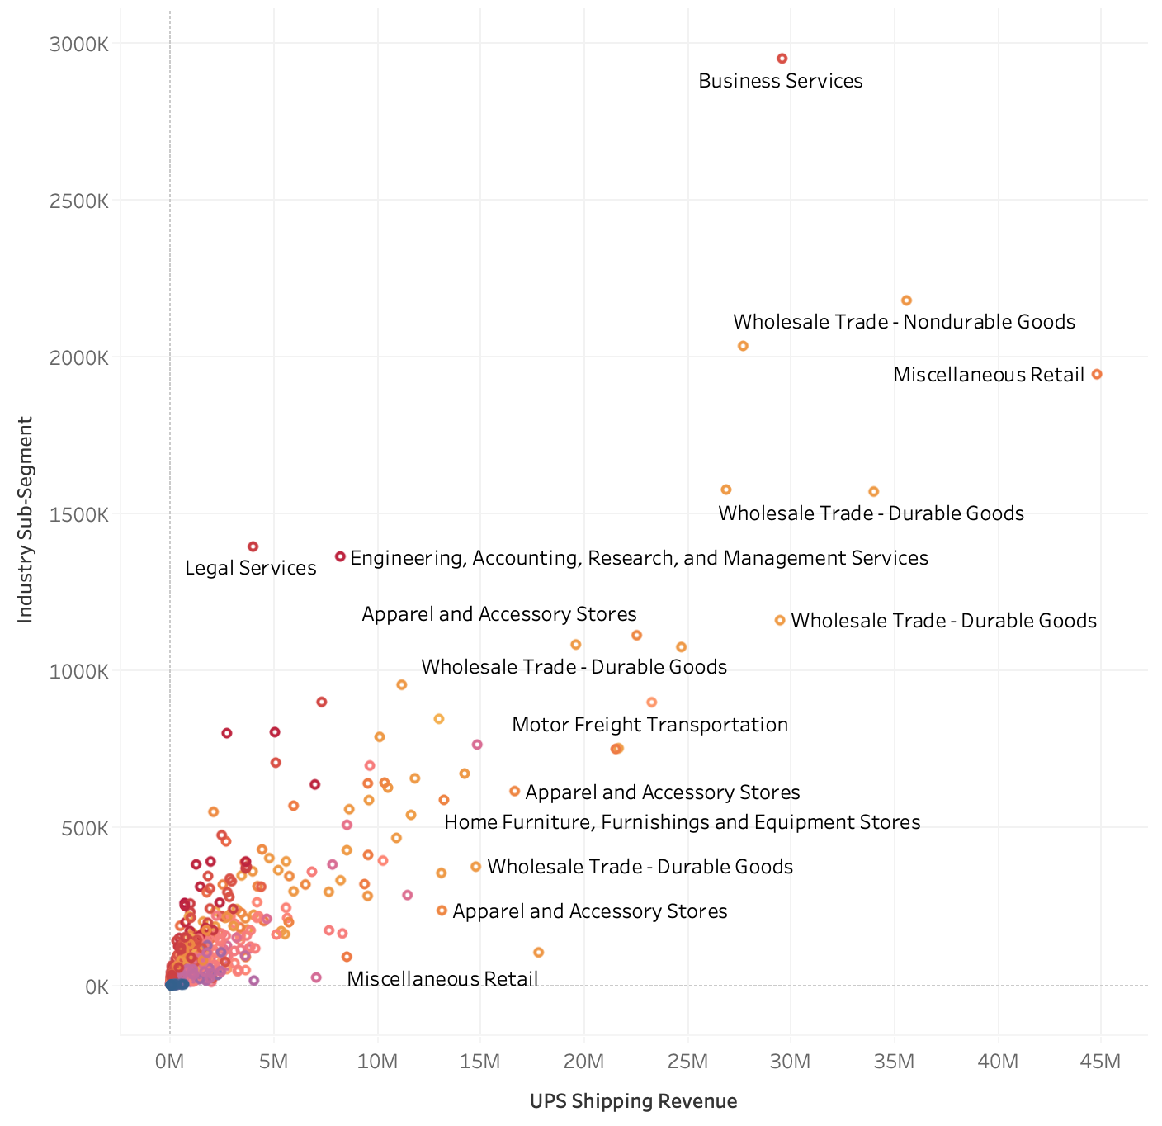
Tableau
INDUSTRY
SUB-
SEGMENT $

Slide 15
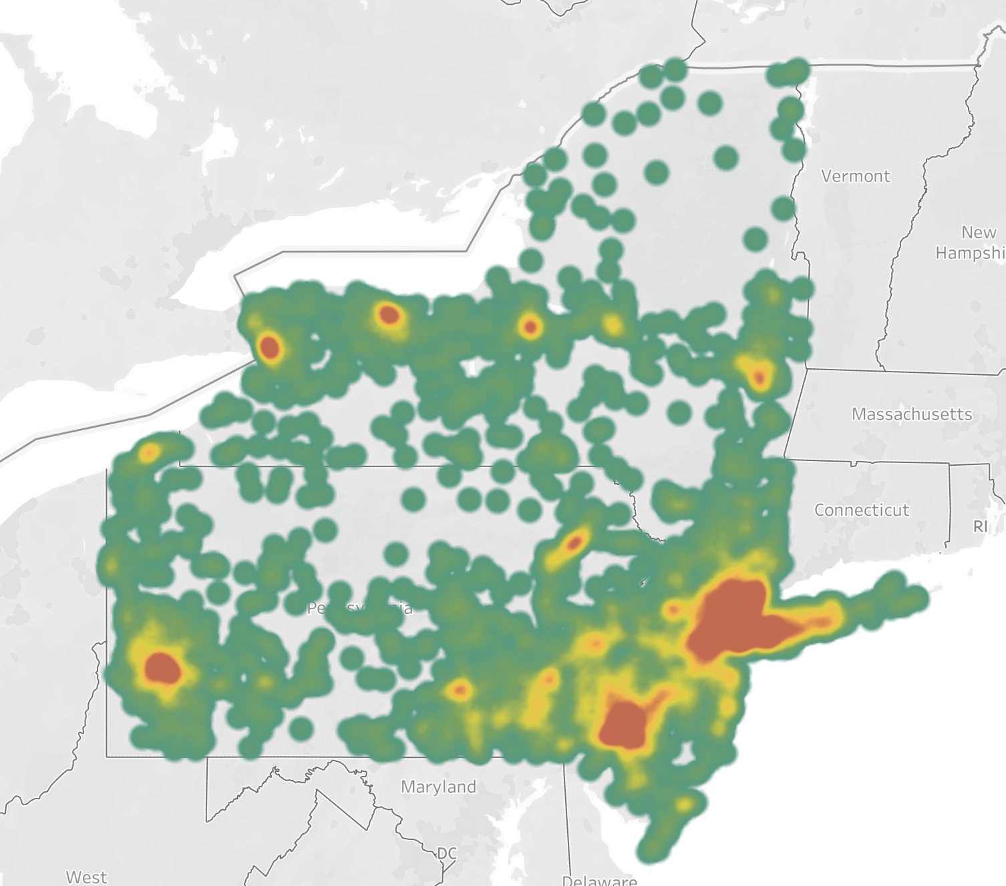
Tableau
Heat map

Slide 16
RESULTS, FINDINGS & CONCLUSION
IDENTIFIED OVER $500+ MILLION OF NEW BUSINESS OPPORTUNITIES FOR CLIENT IN GEOGRAPHY
CLIENT IS ABLE TO BETTER ALLOCATE, RE-ALIGN & RE-DEPLOY MARKETING SPEND & FIELD SALES RESOURCES WITH FINDINGS
FUTURE IMPROVEMENTS – MAP WITH LEAFLET AND CREATE WEB TOOL FOR MARKETING & FIELD SALES
FUTURE IMPROVEMENTS – USE OTHER DATA SOURCES TO CROSS-REFERENCE & IMPROVE MODEL ACCURACY

Slide 17

QUESTIONS?
comments?
insults?

